Slide 1
Cluster Analysis v2

Slide 2
Cluster 1: "Hard-Core Cyclists” (11% of respondents)
Hardcore Cyclists ("Dedicated Cyclists”)
Less likely to be bothered by inclement weather or effort
Less likely for time/efficiency to be a concern
Slightly more likely to avoid cars
More likely to be concerned with route infrastructure
Slightly more likely to experience peer or institutional encouragement
More likely to enjoy cycling and identify with cycling culture
More likely to have had parental encouragement

Slide 3
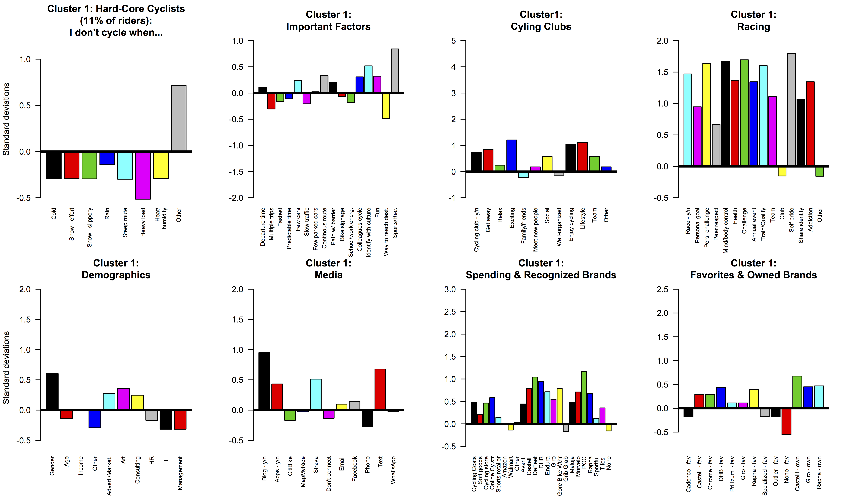

Slide 4
Cluster 2: "Dedicated Lone-Wolves” (39% of respondents)
Dedicate Lone-Wolves ("Path-Using Cyclists”)
Less likely to be bothered by inclement weather or effort
More likely for time/efficiency to be a concern
More likely to avoid cars
More likely to be concerned with route infrastructure
More likely to experience peer or institutional encouragement
More likely to enjoy cycling and identify with cycling culture
More likely to have had parental encouragement

Slide 5
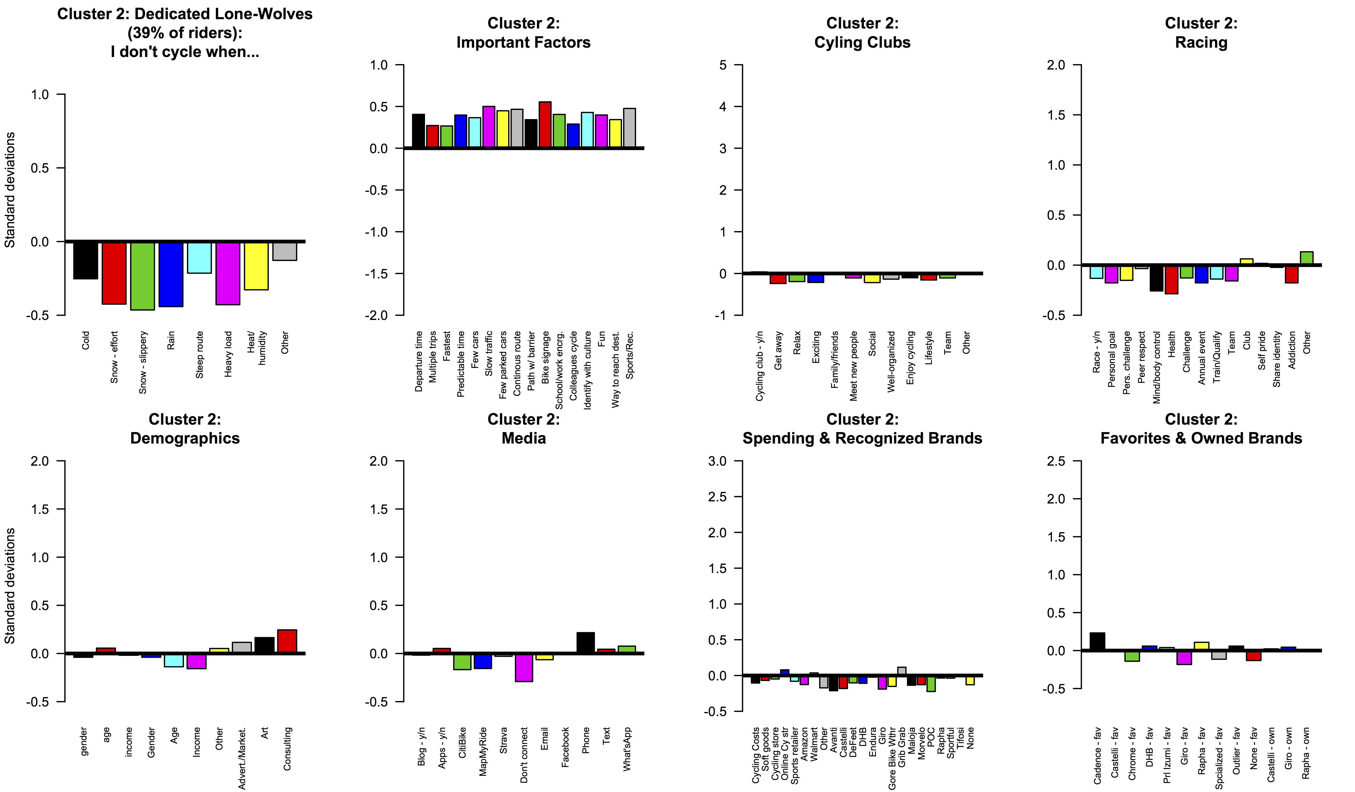

Slide 6
Cluster 3: "Fair-Weather Cyclists” (47% of respondents)
Fair Weather Cyclists ("Fairweather Utilitarians”)
More likely to be bothered by inclement weather or effort
Less likely for time/efficiency to be a concern
Less likely to avoid cars
Less likely to be concerned with route infrastructure
Less likely to experience peer or institutional encouragement
Less likely to enjoy cycling and identify with cycling culture
Less likely to have had parental encouragement

Slide 7
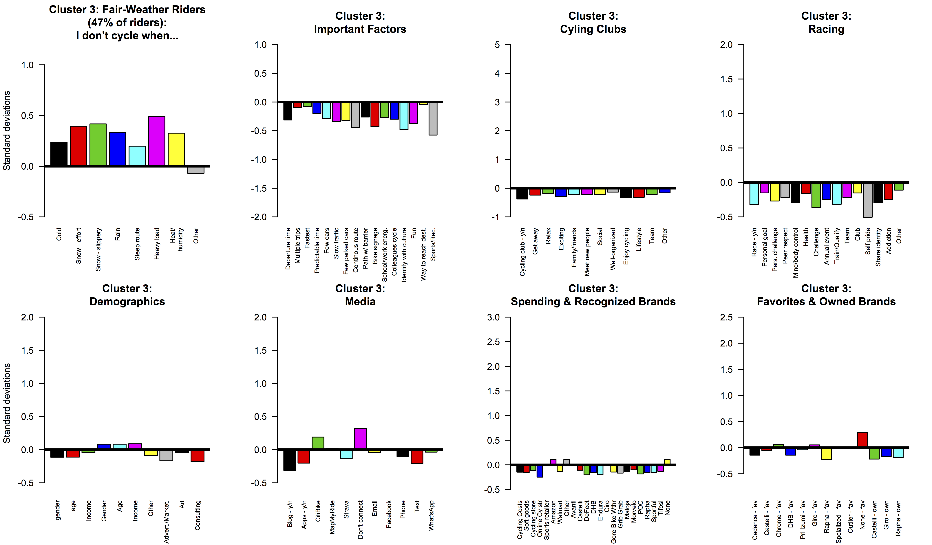

Slide 8
Cluster 4: "Social Cyclists” (3% of respondents)
Social Cyclists ("Leisure Cyclists”)
Much more likely to be bothered by inclement weather or effort
Much less likely for time/efficiency to be a concern
Much less likely to avoid cars
Less likely to be concerned with route infrastructure
Less likely to experience peer or institutional encouragement
Less likely to enjoy cycling and identify with cycling culture
Much less likely to have had parental encouragement

Slide 9
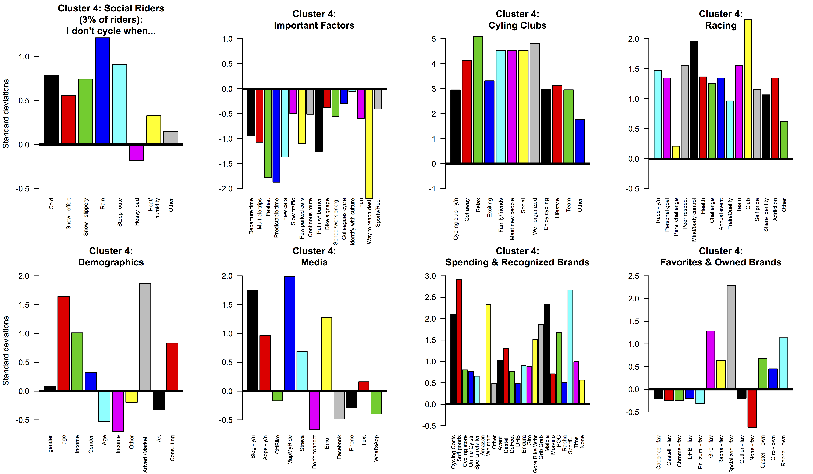

Slide 10
